Slide 1
Databases and the Web IS53064A
Lecture X.X
Security of Data In Transit

Slide 2
Recap

Slide 3

Threats
What are the threats to data?
Hackers
Disgruntled employees
Careless employees
Industrial espionage
Terrorism
Natural disasters
Hardware failure
Power failure
Data leakage

Slide 4








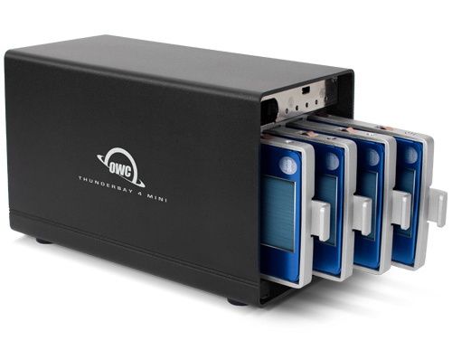


How can we protect against risks?
Access control
Separation of duties
Physical security
Regularly apply security patches and updates
Encryption
Have a disaster recovery plan
Redundancy
Backup

Slide 5

How can we protect against risks?
Access control
Separation of duties
Physical security
Data in Storage
Regularly apply security patches and updates
Encryption
Have a disaster recovery plan
Redundancy
Backup

Slide 6
Data in Transit

Slide 7
Data in Transit
Security issues? What are they?
HTTP is sent in plain text
Can be intercepted
Think about all the sensitive info in messages – passwords, etc
Packet sniffers:
https://www.dnsstuff.com/packet-sniffers
How can we protect our data in transit?

Slide 8
Symmetric Encryption

Slide 9


Symmetric Encryption
Public space
Alice
Bob
TOP SECRET
Alice has a document she wants to send to Bob

Slide 10
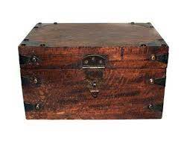
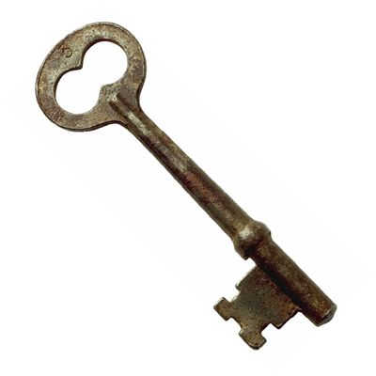

Symmetric Encryption
Public space
Alice
Bob
TOP SECRET
Alice has a document she wants to send to Bob
She locks it in a box with a key and sends it to Bob

Slide 11
Symmetric Encryption
Public space
Alice
Bob
TOP SECRET
Alice has a document she wants to send to Bob
She locks it in a box with a key and sends it to Bob
For Bob to be able to open it she needs to send him a copy of the key

Slide 12
Symmetric Encryption
Public space
Alice
Bob
TOP SECRET
Alice has a document she wants to send to Bob
She locks it in a box with a key and sends it to Bob
For Bob to be able to open it she needs to send him a copy of the key
When he gets the key, he can open the box

Slide 13
Symmetric Encryption
Public space
Alice
TOP SECRET
Bob
I’m the man in the middle
But anyone can intercept the package and the key and open the box
A man-in-the-middle attack is where someone eavesdrops on messages and potentially alters the messages

Slide 14
Asymmetric Encryption

Slide 15


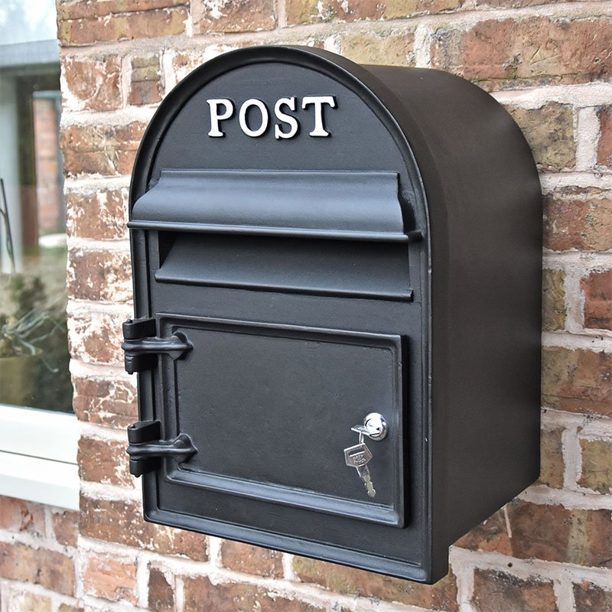





Asymmetric Encryption
Mailbox analogy
Everyone can post to the mailbox
Only the owner (with the key) can open it and read messages

Slide 16
Asymmetric Encryption
Public space
TOP SECRET
Alice
Bob
Alice and Bob want to send each other messages securely

Slide 17
Asymmetric Encryption
Public space
Alice
Bob
Alice’s private key
Bob’s private key
Alice’s public key
Bob’s public key
They each create 2 keys – a public key and a private key
The public key can be used to lock a box
Only the private key can be used to open a box

Slide 18
Asymmetric Encryption
Public space
Alice
Bob
Alice’s private key
Bob’s private key
Alice’s public key
Bob’s public key
Bob’s public key
Alice’s public key
Now Alice and Bob share their public keys

Slide 19


Asymmetric Encryption
Public space
Alice
Bob
Alice’s private key
Bob’s private key
Alice’s public key
Bob’s public key
Bob’s public key
Alice’s public key
Alice wants to send a message to Bob
She puts it in a box and locks it with Bob’s public key

Slide 20
Asymmetric Encryption
Public space
Alice
Bob
Alice’s private key
Bob’s private key
Alice’s public key
Bob’s public key
Bob’s public key
Alice’s public key
Alice wants to send a message to Bob
She puts it in a box and locks it with Bob’s public key and sends it
Bob can use his private key to unlock the parcel

Slide 21
Asymmetric Encryption
Public space
Darn!
Alice
Bob
Alice’s private key
Bob’s private key
Alice’s public key
Bob’s public key
Bob’s public key
Alice’s public key
Alice wants to send a message to Bob
She puts it in a box and locks it with Bob’s public key and sends it
Bob can use his private key to unlock the parcel
No one else can decrypt the message (because no one else has Bob’s private key)!

Slide 22
Asymmetric Encryption
Public space
Double darn!
Alice
Bob
Alice’s private key
Bob’s private key
Alice’s public key
Bob’s public key
Bob’s public key
Alice’s public key
Alice wants to send a message to Bob
She puts it in a box and locks it with Bob’s public key and sends it
Bob can use his private key to unlock the parcel
No one else can decrypt the message (because no one else has Bob’s private key)!
Even if he intercepts the public keys, it doesn’t help our hooded hacker

Slide 23
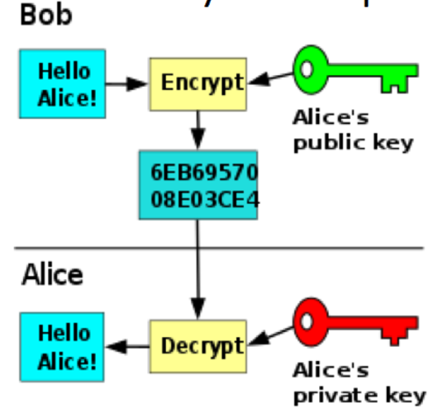
RSA algorithm
The RSA algorithm is used to generate public and private keys
They are mathematically linked, but can’t be derived from each other
The public key is used to encrypt data
Only the private key can be used to decrypt data

Slide 24
Symmetric vs Asymmetric
Symmetric: Same key to open and close the box
Asymmetric: Different keys to open and close the box
open
close

Slide 25
Symmetric vs Asymmetric
Symmetric
encrypt
decrypt
“Meet me under the bridge”
“Meet me under the bridge”
“dsa3sfs34w3w”
Asymmetric
encrypt
decrypt
“Meet me under the bridge”
“Meet me under the bridge”
“3ijsdiu34nalg”
Doesn’t matter which key is declared public or private
But the one declared private must not be shared!

Slide 26



But there’s more!
The keys and locks are a bit special!
They have 3 positions: UNLOCKed and locked at A and B!
UNLOCK
UNLOCK
UNLOCK
A
B
A
B
A
B
Private key:
Turns clockwise
Public key:
Turns anticlockwise

Slide 27
Normal asymmetric encryption
Public space
UNLOCK
UNLOCK
A
B
A
B
Bob encrypts a message using Alice’s public key
Alice can decrypt the message using her private key

Slide 28


What about this?
Public space
UNLOCK
UNLOCK
A
B
A
B
Bob encrypts a message using his own private key!
Anyone with his public key would be able to decrypt his message!
Why on earth would he do that?

Slide 29
Digital signatures
Public space
UNLOCK
UNLOCK
A
B
A
B
Bob encrypts a message using his own private key!
Anyone with his public key would be able to decrypt his message!
Anyone receiving the message will be sure it’s from Bob if they can open the box

Slide 30
Digital signatures
Signed doc
Signed doc
I’ve received the secret dossier
I’ve received the secret dossier
Bob sends signed document to Alice
I’ve received the secret dossier
HASH
(*nas93qoqawheq8 qoh8 2kh DDk9mj890lkj ( 80kjhjkhkjhjh9(
(*nas93qoqawheq8 qoh8 2kh DDk9mj890lkj ( 80kjhjkhkjhjh9(
Fkij2390udnquweweweqw2qj 0q39ue0q9uemee4q09ueqe
HASH
e.g. SHA256
Bob’s public key
Decrypt
Fkij2390udnquweweweqw2qj 0q39ue0q9uemee4q09ueqe
Bob’s private key
(*nas93qoqawheq8 qoh8 2kh DDk9mj890lkj ( 80kjhjkhkjhjh9(
Fkij2390udnquweweweqw2qj 0q39ue0q9uemee4q09ueqe
If these match, Alice knows that the message has not been tampered with
Encrypt
“digest”
digital signature
Note, this is not encrypting the document itself
Essentially the encrypted digest

Slide 31
Digital signatures
Signed doc
Signed doc
I’ve received the secret dossier
I’ve received the secret dossier
Bob sends signed document to Alice
BUT, how does Alice know that “Bob” is not in fact our hooded hacker?
I’ve received the secret dossier
HASH
(*nas93qoqawheq8 qoh8 2kh DDk9mj890lkj ( 80kjhjkhkjhjh9(
(*nas93qoqawheq8 qoh8 2kh DDk9mj890lkj ( 80kjhjkhkjhjh9(
Fkij2390udnquweweweqw2qj 0q39ue0q9uemee4q09ueqe
HASH
e.g. SHA256
Bob’s public key
Decrypt
Fkij2390udnquweweweqw2qj 0q39ue0q9uemee4q09ueqe
Bob’s private key
(*nas93qoqawheq8 qoh8 2kh DDk9mj890lkj ( 80kjhjkhkjhjh9(
Fkij2390udnquweweweqw2qj 0q39ue0q9uemee4q09ueqe
If these match, Alice knows that the message has not been tampered with
Encrypt
“digest”
digital signature
Note, this is not encrypting the document itself
Essentially the encrypted digest

Slide 32
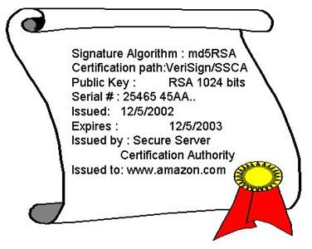
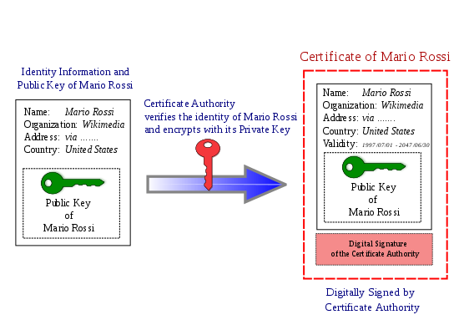
Digital Certificates
A form of identity verification
Like a driver’s licence
Contain a copy of a public key of the certificate holder
Issued by a certificate authority (CA) which sign the certificate to verify the identity
So it crytopgraphically links ownership of a public key with an entity
Digital certificates include:
The public key being certified
Identifying information about the entity that owns it
A digital signature of the public key created by the issuer
Other metadata, e.g. the type of encryption, expiry date, etc
Also called public key certificate
https://teaching.shu.ac.uk/aces/rh1/ebiz/what_is_%20digital_certificate.htm
https://en.wikipedia.org/wiki/Certificate_authority
Some Certification Authorities
Let’s Encrypt
DigiCert
GoDaddy
GlobalSign

Slide 33
The Maths of Public/Private Keys

Slide 34
How do the keys work?
p = 11 Select a prime
q = 17 Select another prime
n = p * q = 187 Compute n
φ(n) = (p-1) * (q-1) = 160 Compute Euler's totient
e = 23 Select e, a coprime of φ(n)
e^-1 = d(mod(φ(n)) Compute d from this
d = 7
Private Key:
n = 187, d = 7
Public Key:
n = 187, e = 23
Taken from here:
https://www.learnsteps.com/the-math-behind-public-key-cryptography-which-is-also-used-in-ssh/

Slide 35
How do the keys work?
Now lets encrypt a message with these keys
Message: G (ascii character 71)
Encrypt with public key:
encrypt(71) = 71^23 mod 187
= 147
Now lets decrypt it with private key:
decrypt(147) = 147^7 mod 187
= 71
Private Key:
n = 187, d = 7
Public Key:
n = 187, e = 23

Slide 36
How do the keys work?
We used small primes.
p = 11
q = 17
In real life, much larger primes are used to achieve the required level of security (uncrackability).

Slide 37
Key size
Number of bits in a key
128
256
1024
2048
More bits = more secure (requiring more computing power to crack by brute force)

Slide 38
Applications of Asymmetric Encryption

Slide 39
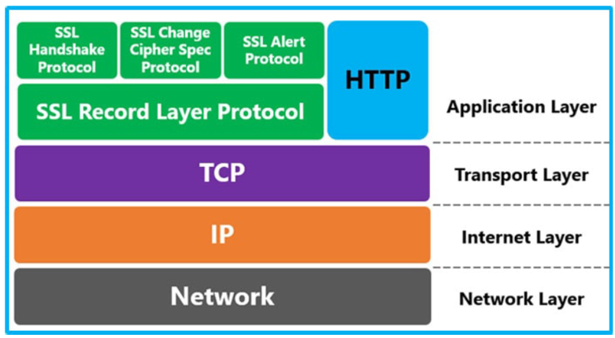
TLS / SSL
Provides secure transmission over a network
TLS is the modern standard (SSL is older)
These days, when people say SSL they mean TLS
Uses asymmetric encryption for the session keys and symmetric encryption to send data within the secure session

Slide 40
TLS
Prevents intruders from tampering with messages
Prevents intruders from passively listening to messages
Protects sensitive data being transmitted over the internet. Login credentials, credit card details, etc.
Use it!!!

Slide 41
HTTPS
HTTPS stands for HTTP over SSL
But of course SSL means TLS!
So TLS is used to encrypt the HTTP messages
A website must have a TLS certificate for this to work

Slide 42
HTTPS process
The client contacts the server using a secure URL (https://...).
The server sends the client its certificate and public key.
The client verifies this with a Trusted Root Certification Authority to ensure the certificate is legitimate.
The client and server negotiate the strongest type of encryption that each can support.
The client encrypts a session key with the server’s public key, and sends it back to the server.
The server decrypts the client communication with its private key, and the session is established.
The session key (symmetric encryption) is now used to encrypt and decrypt data transmitted between the client and server.
Fomr: https://www.f5.com/services/resources/glossary/ssl-tls-encryption#:~:text=SSL%2FTLS%20uses%20both%20asymmetric,data%20within%20the%20secured%20session.

Slide 43
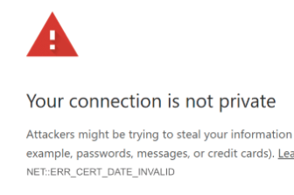

Why HTTPS
Not just security
Google expects it. Your pages will be ranked lower if you don’t support it
Users will get a horrible warning message:
Users want to see the lock icon:

Slide 44

FTP
FTP allows bulk file transfers between remote computers. Directories can be browsed, created, deleted. Essentially you get remote file system access
E.g. Filezilla
FTP sits on TCP
However, it was designed at a time when the use of the internet was limited and network threats were not of real concern
As seen in the labs!
FTP

Slide 45
FTPS
FTPS is a secure version of FTP which adds TLS for encryption and secure key exchange
SFTP
SFTP is a secure version of SSH with added file transfer features
Check out this article to understand the difference: https://www.spiceworks.com/tech/networking/articles/sftp-vs-ftps/#:~:text=SFTP%20builds%20on%20secure%20shell,a%20security%20and%20encryption%20layer.&text=It%20uses%20a%20single%20connection,easier%20to%20install%20firewall%20solutions.

Slide 46
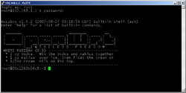
SSH
Provides remote login and command-line execution
Does not use TLS or digital certificates
As seen in the labs!

Slide 47
SSH vs TLS security
They have strong similarities:
Data-in-motion encryption
Server authentication
Client authentication
Data integrity mechanisms
There are differences
TLS normally requires digital certificates for server and client authentication, but SSH does not
TLS this needs the presence of public key infrastructure (PKI) and a certificate authority (CA)

Slide 48
Other things for you to research
SMTP, POP, IMAP security
WebDAV, Rsync
SHA-1, SHA-256, etc
MD5
RSA vs AES
SHA vs RSA

Slide 49
END OF SLIDES

